Slide 1
COVID 19 GLOBAL FORECASTING
By Kaggle
Challenge Accepted
2019 - 2020

Slide 2






Challenge Accepted
Faydi Mariem
Mensi Iheb
Guemira Marwa
Smari Mariem
Bel Hadj Slimen Nada
Ben Ammar Anja

Slide 3
TABLE OF CONTENTS
01
02
03
04
05
Introduction
Data Understanding
Data Visualization
Data Modeling
Conclusion

Slide 4
INTRODUCTION

Slide 5
Machine Learning
Supervised Learning
Unsupervised Learning
Classification
Regression
Clustering
Recommendation System

Slide 6
Data Science Lifecycle
Business Understanding
Analytic approach
Feedback
Data Requirement
Deployment
Data Collection
Evaluation
Data Understanding
Modeling
Data Preparation

Slide 7
01
DATA VISUALISATION
&
DATA UNDERSTANDING

Slide 8
DATA VISUALISATION
&
DATA UNDERSTANDING

Slide 9
DATA UNDERSTANDING
Train.csv
01
Test.csv
02
03
Submission.csv
The training Data
The dataset to predict
Notes:
Data Source
This evaluation data for this competition comes from John Hopkins CSSE, which is uninvolved in the competition.
They are currently updating the data daily.

Slide 10
DATA UNDERSTANDING
Province_State | Country_Region | Date | ConfirmedCases | FatalitiesCases
Italy | Italy | 13/05/2020 | 222104 | 31106
Tunisia | Tunisia | 13/05/2020 | 1032 | 45

Slide 11
4,837,361
Data Visualization
Cases detected
6.4%
93.6%
Confirmed Cases
Fatalities Cases

Slide 12
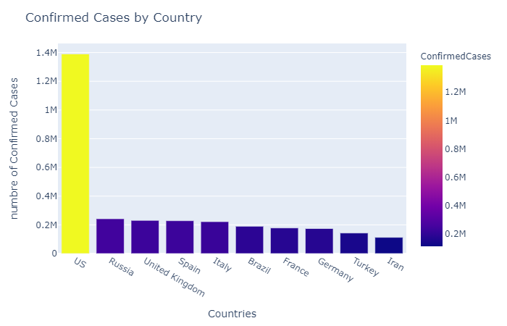
Data Visualization
Top 10 Confirmed Cases By country

Slide 13
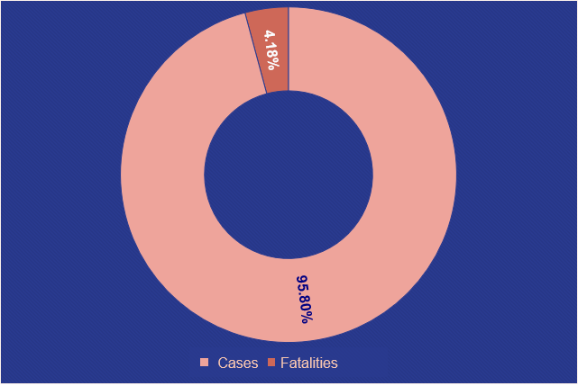
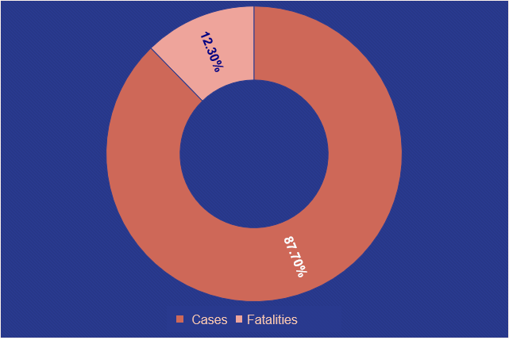
Data Visualization
Tunisia
Italy

Slide 14
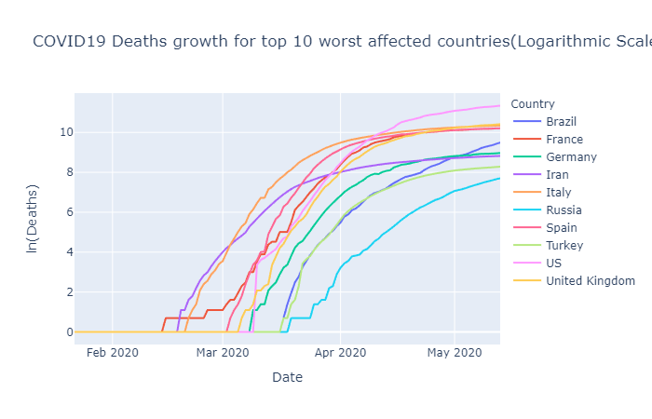
Data Visualization
Deaths growth for top 10 worst affected countries

Slide 15
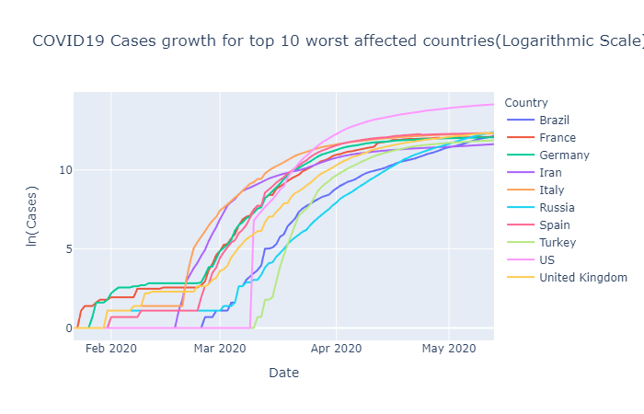
Data Visualization
Cases growth for top 10 worst affected countries

Slide 16
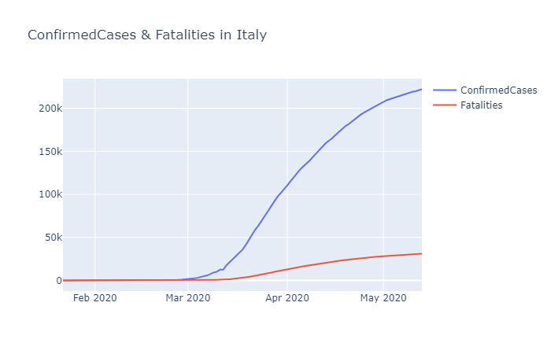
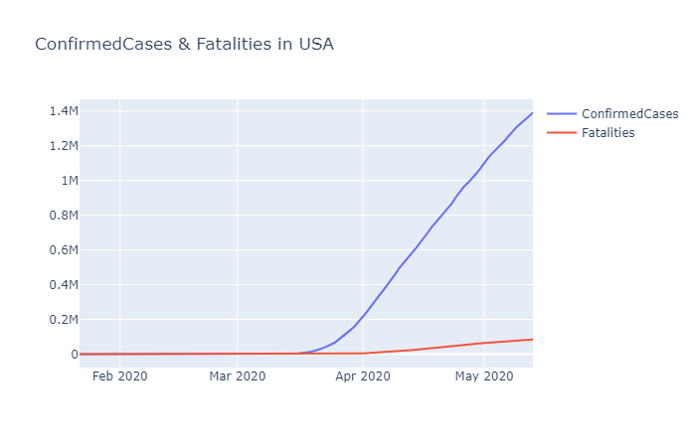
Confirmed and Fatalities cases in Italy
Confirmed and Fatalities cases in USA

Slide 17
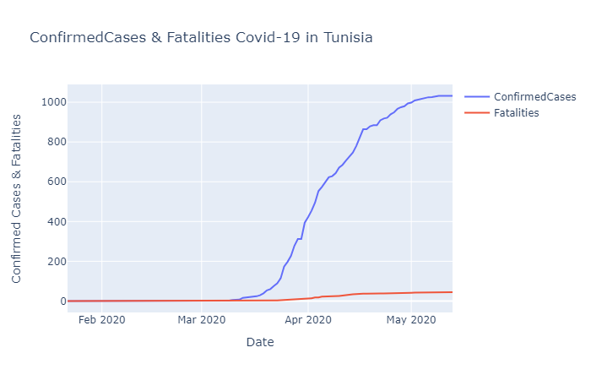
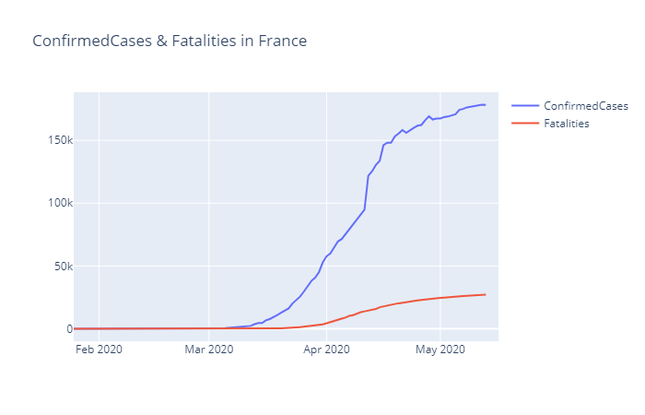
Confirmed and Fatalities cases in Tunisia
Confirmed and Fatalities cases in France

Slide 18
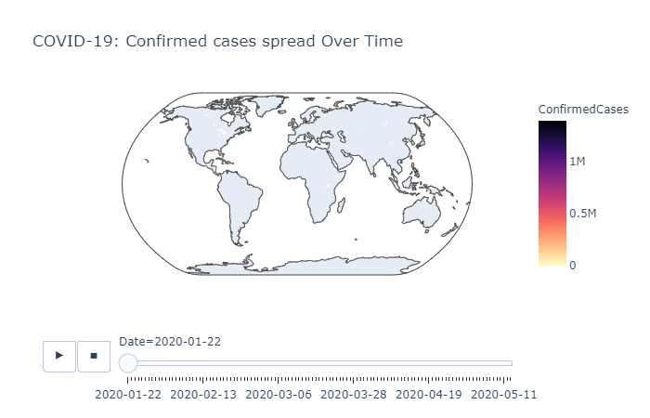
Data Visualization
Confirmed Cases spread over time

Slide 19
01
DATA PREPARATION

Slide 20
Feature generation (1/2)
Create features from “Date” Feature
Date
2020-01-22
2020-01-23
2020-01-24
………
2020-05-12
2020-05-13
2020-05-14
dayofweek | quarter | month | dayofyear | dayofmonth | weekofyear
2 | 1 | 1 | 22 | 22 | 4
3 | 1 | 1 | 23 | 23 | 4
4 | 1 | 1 | 24 | 24 | 4
……………
1 | 2 | 5 | 133 | 12 | 20
2 | 2 | 5 | 134 | 13 | 20
3 | 2 | 5 | 135 | 14 | 20

Slide 21
Feature generation (2/2)
Merge the Country feature with the state Feature
Province_state | Country_Region
New Brunswick | Canada
Nan | Bolivia
Nan | Tunisia
Jilin | China
Idaho | US
Queensland | Australia
Nan | Germany
Nan | France
Country_Sate
Canada_New Brunswick
Bolivia_
Tunisia_
China_Jilin
US_Idaho
Australia_Queensland
Germany_
France_
Country_State
69
39
387
71
417
24
126
105

Slide 22
01
DATA
MODELING

Slide 23
Data Modeling
01
03
05
Ridge
ARIMA
SVM
XGboost
CART
02
04

Slide 24
XGboost
Extreme Gradient Boosting
Custom tree building algorithm
Used for :
Interface for Python & R
classification
Regression
Ranking

Slide 25
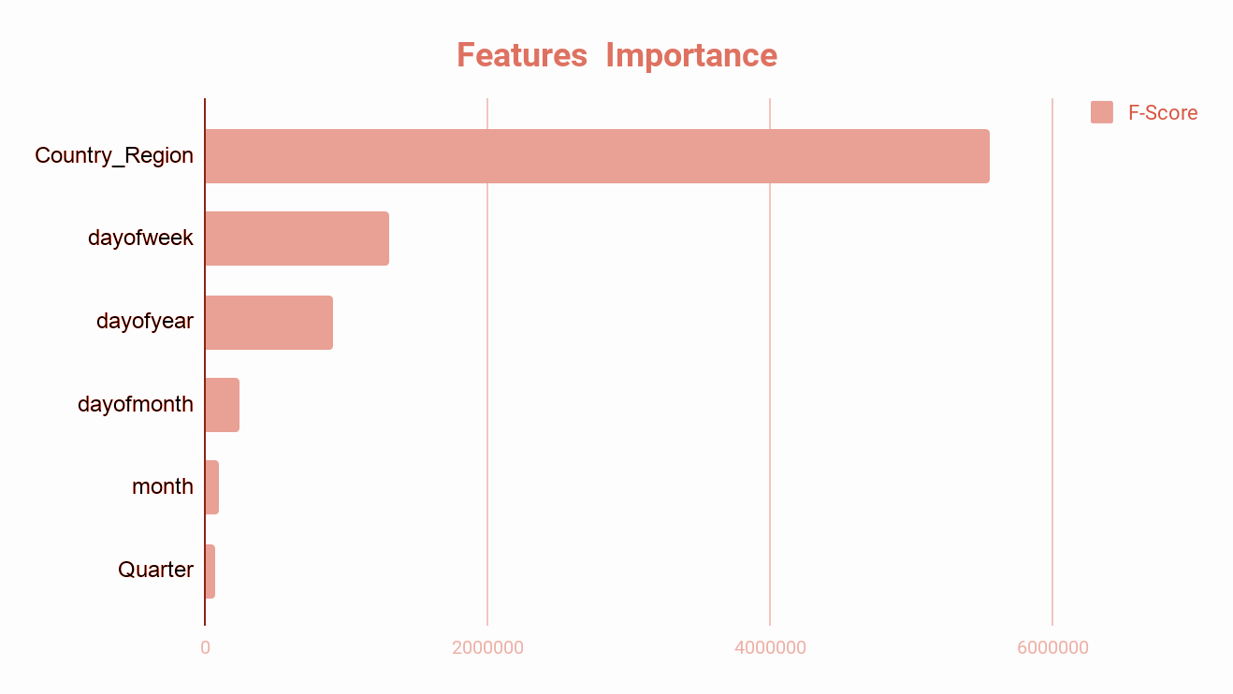
Features Importance
Features
F score

Slide 26
XGboost
01
02
03
04
0,9
135.2
780.09
0,9
RMSE
2
SCORE
MAE
R

Slide 27
RIDGE
Add a penalty term to reduce overfitting
Reduce the model complexity
Used for :
Better long term prediction
Classification
Regularisation
Shrinkage Estimator

Slide 28
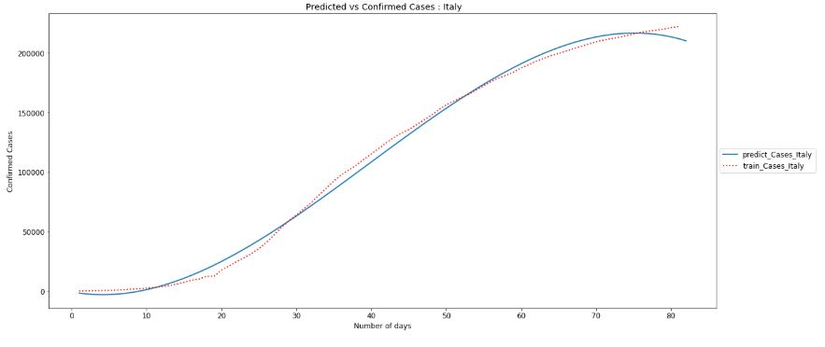
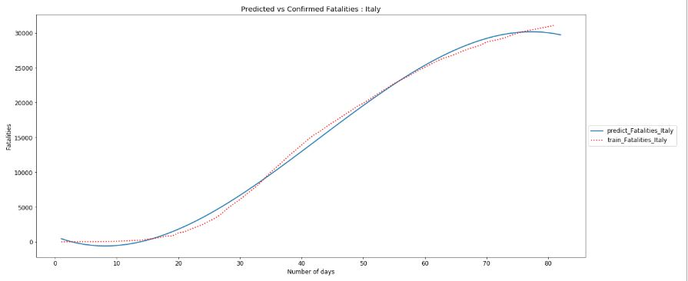
Prediction Cases & Fatalities in ITALY with RIDGE

Slide 29
CART
Predictive model :
helps to find a variable based on other labeled variables
The representation for the model is a binary tree
Able to capture the non-linearity in the dataset
(Classification And Regression Trees)
The leaf node will tell the final prediction

Slide 30
ARIMA
ARIMA(p,d,q)
p : The Lag Order
q:The order of moving average
d: The degree of differencing
AR: AutoRegression
I: Integrated
MA: Moving Average
Used for :
Interface for Python & R
Understand the data
Eliminate the non-stationarity
Predicting future points in the series(Forecasting)

Slide 31
SVM ( Support Vector Machine)
Effective in high dimensional spaces
Used for :
Interface for Python & R
Finding an hyper-plane that differentiates between the classes very well
Classification
Regression

Slide 32
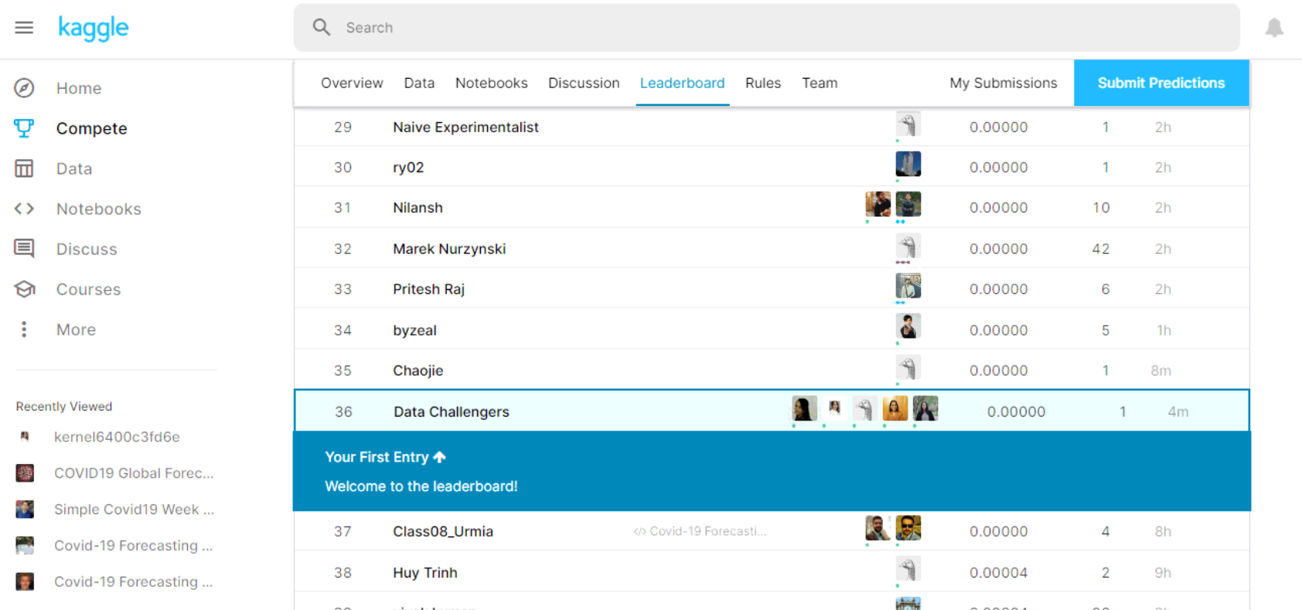
Kaggle Competition

Slide 33
Stay Safe
Stay at Home
Thank You

Slide 34
Medical Icons

Slide 35
Business Icons
Teamwork Icons

Slide 36
Help & Support Icons
Avatar Icons

